Slide 1
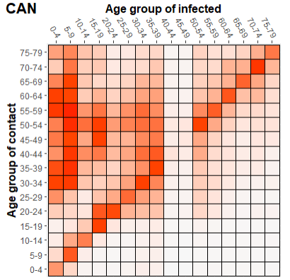
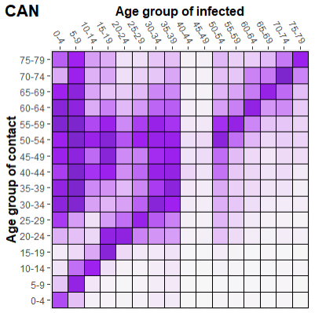



Canada walkthrough (k = CAN)
c = (PF eig-value of SCV) / ($R_{0}$ estimate for CAN)
c = 16.75229 / 2.739643 = 6.114771

Slide 2
Constants of Proportionality
Country | alpha
CAN | 6.114771
CHN | 7.358265
GBR | 4.737637
ISR | 5.289702
ITA | 7.978819
NLD | 8.609081
In the same ballpark, but definitely not similar or close

Slide 3

Canada

Slide 4
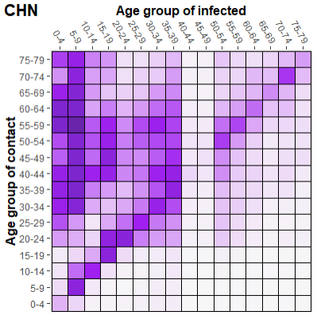
China

Slide 5
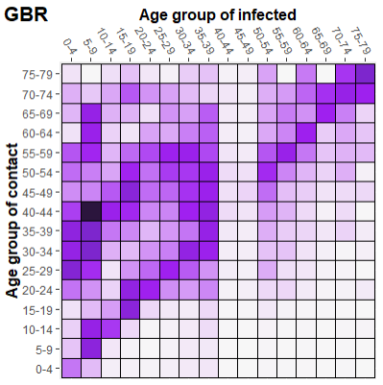
United Kingdom

Slide 6
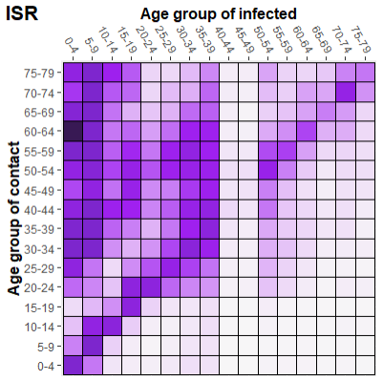
Israel

Slide 7
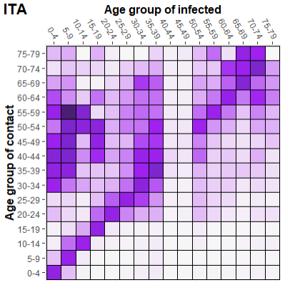
Italy

Slide 8
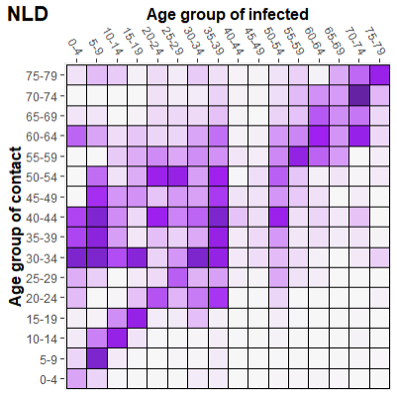
Netherlands

